Slide 1
Toronto Crime Analysis Presentation

Slide 2

Team 2
Dikeshkumar Patel – 0794600​
Parthkumar Dhameliya - 0784114​
​Kajal Arora – 0774848​
Amandeep Kaur - 0793780​
Kanishk Tripathi - 0789972

Slide 3
Basic About Toronto Crime
Over the past few years, Toronto has experienced a fluctuation in crime rates, with varying increases and decreases across different types of crimes. From 2016 to 2020, the city saw increases in homicides, shootings, and hate crimes, while other types of crimes such as break and enters, auto theft, and fraud saw a decrease or stabilization.
According to the Toronto Police Service's 2020 Annual Statistical Report, there were 93 homicides in Toronto in 2020, which was a 9% increase from the previous year. In addition, there were increases in several other types of violent crimes, including shootings, sexual assaults, and assaults causing bodily harm. Property crime, such as theft and break-ins, also increased in 2020.

Slide 4
Business Objective
Our goal is to provide a platform for people and government organizations to analyze different types of crime in Toronto. ​
It will give depth analyses to government organizations on which they can take action on specific types of crime-based analysis. So, it will help them to reduce crime. ​
For other people, it will provide awareness of crime happening around their areas.

Slide 5
Business Objective
The business objective of analyzing crime in Toronto could be to identify patterns and trends in criminal activity that can help businesses make informed decisions about their operations in the city.
Identify high-crime areas: By analyzing crime data, businesses can identify areas in the city that have a high incidence of crime. This information can help businesses make decisions about where to locate or expand their operations
Evaluate risks: Crime analysis data to determine theft, or other crime occurring at their location. This information can help businesses develop security plans and take steps to reduce their risk of becoming a target.

Slide 6
Business Objective
Allocate resources: By analyzing crime data, businesses can determine where to allocate resources, such as security personnel and equipment, to mitigate the risk of criminal activity. This can help businesses optimize their security strategies and reduce the costs associated with crime prevention.
Monitor trends: Crime analysis can help businesses monitor trends in criminal activity over time, allowing them to identify emerging threats and adjust their security strategies accordingly.

Slide 7
Business Problem Statement
People are not aware of the crime that is occurring around them as a result of the impact that the problem of crime has on society.​
An appropriate response to this is to examine Toronto's crime trends and give citizens and government agencies a forum.​

Slide 8
Dataset
Toronto Major crime from 2014-06-01 to 2022-06-30
27 Column
0.3 Million Records
https://data.torontopolice.on.ca/datasets/TorontoPS::major-crime-indicators-1/about

Slide 9
Project analysis slide 6
Challenges
Difficulty to find an appropriate dataset​
Data Cleaning​
Always up-to-date by crime records
ML Model developing
Difficulties in web developing
Server and Hosting issue

Slide 10
Project analysis slide 2
Project Phases
ANALYSIS
BRAINSTROMING
TORONTO CRIME
ANALYSIS
IMPLEMENTATION
PROBLEM STATEMENT
MODEL DEVLOPING
DATASET

Slide 11
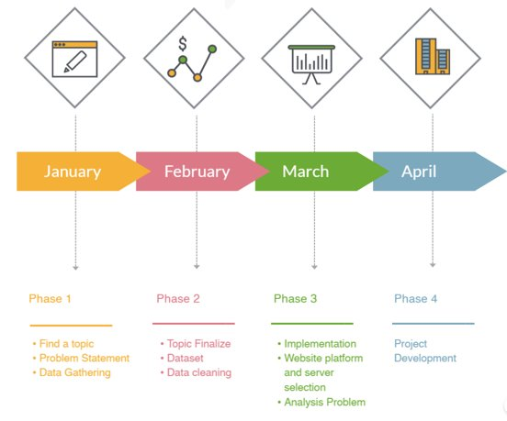
Timeline​

Slide 12
Individual Contribution
Parth and Dikesh are working on analysis, ML model developing, web developing part.
The dataset finding, Web design is done by Kajal.
On the documentation part, Kanishak and Amandeep worked.

Slide 13
TOOLS / TECHNOLOGY/ TECHNIQUE
TABLEAU​
JUPYTER NOTEBOOK​
WEBSITE HOSTING PLATFORM

Slide 14
Project analysis slide 5
Toronto Crime History
Toronto crime analysis
2019-2020
Assault
Auto Theft
20621 in 2019
5624 in 2020
When we compare two-year (2019-2020) crime rate, it was showing crime rate decrease but it was almost same for both year
Assault crime rate was decrease in 2020 compared to 2019
Auto theft crime increase in 2020. It was showing 5624 incident

Slide 15
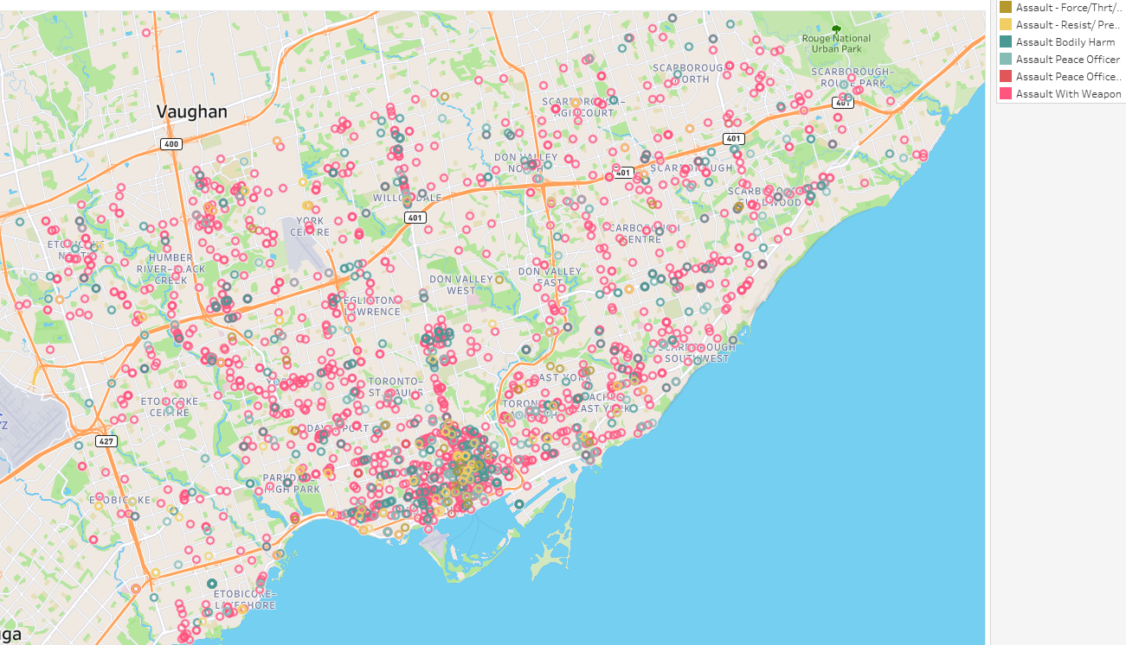
Visualization : By Type Crime Category

Slide 16
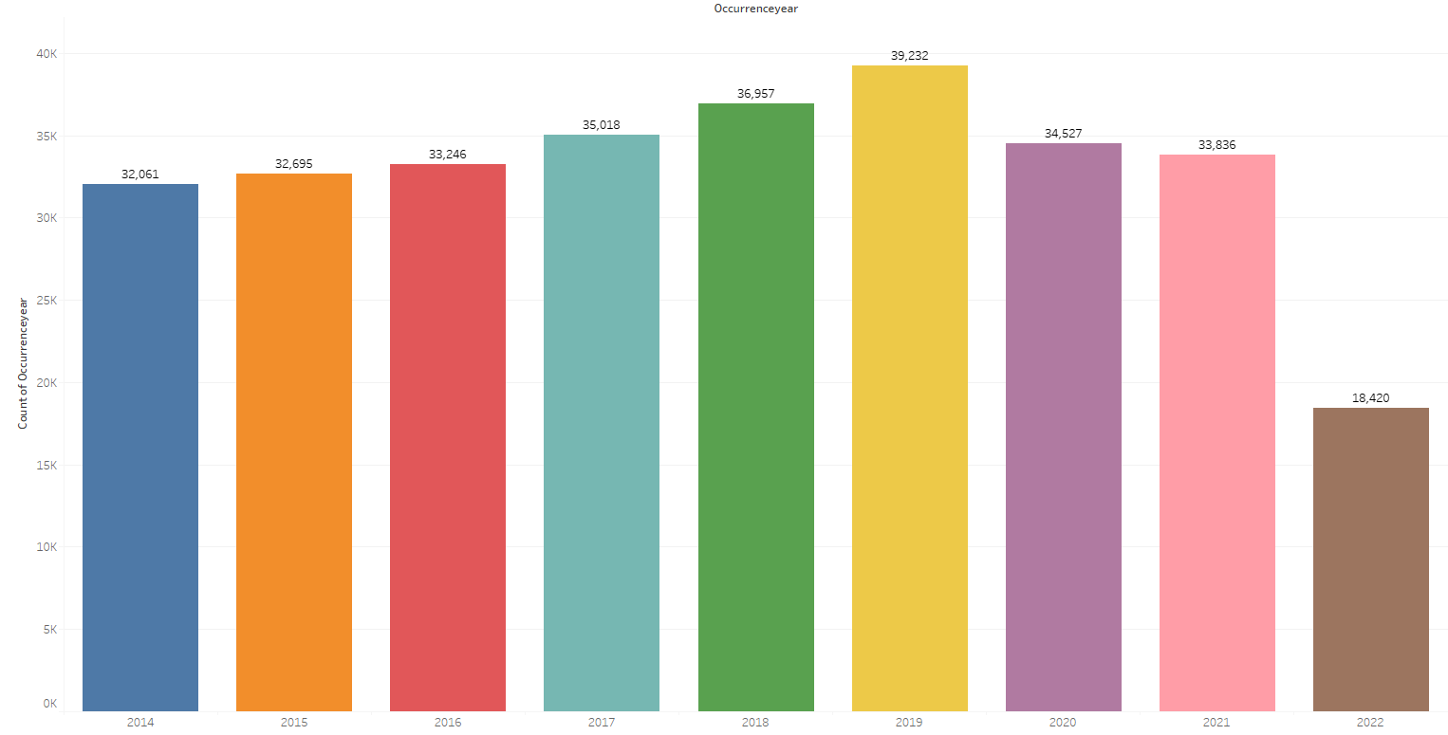
Visualization : Crime Occurrence By Year

Slide 17
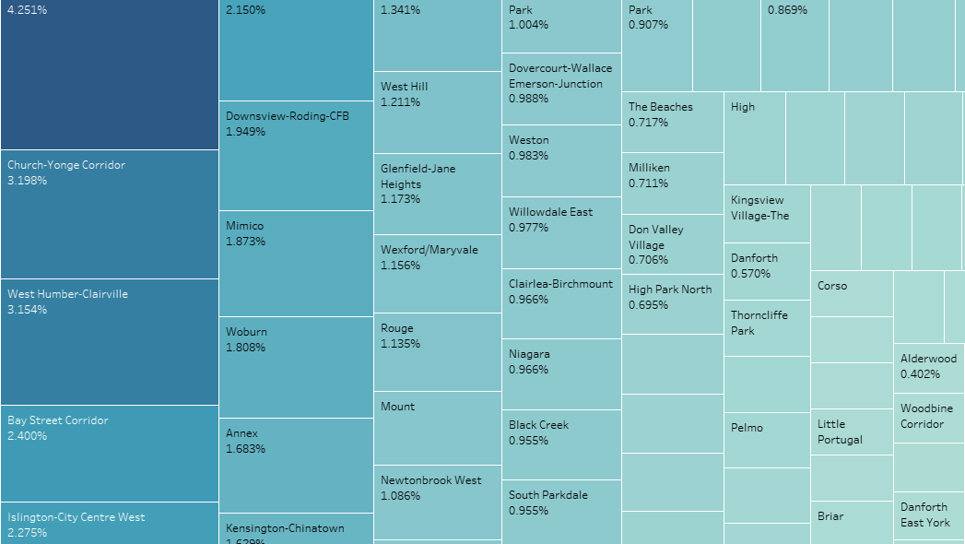
Visualization : Street Crime Rate

Slide 18
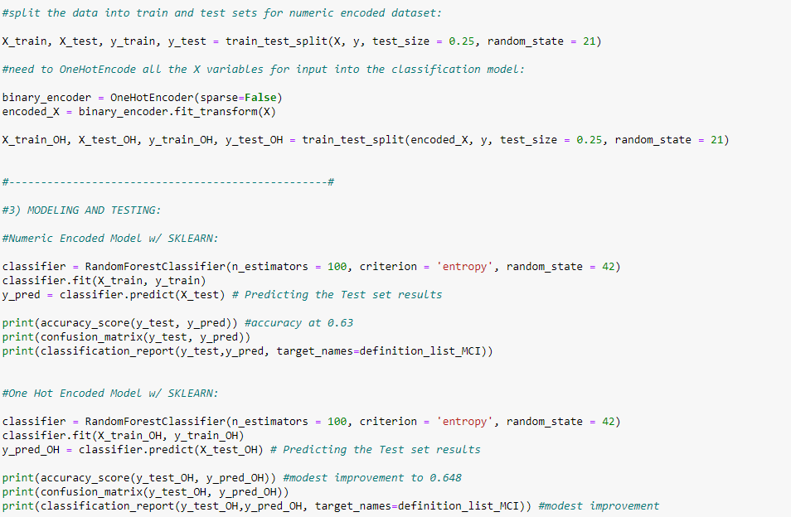
ML Model

Slide 19
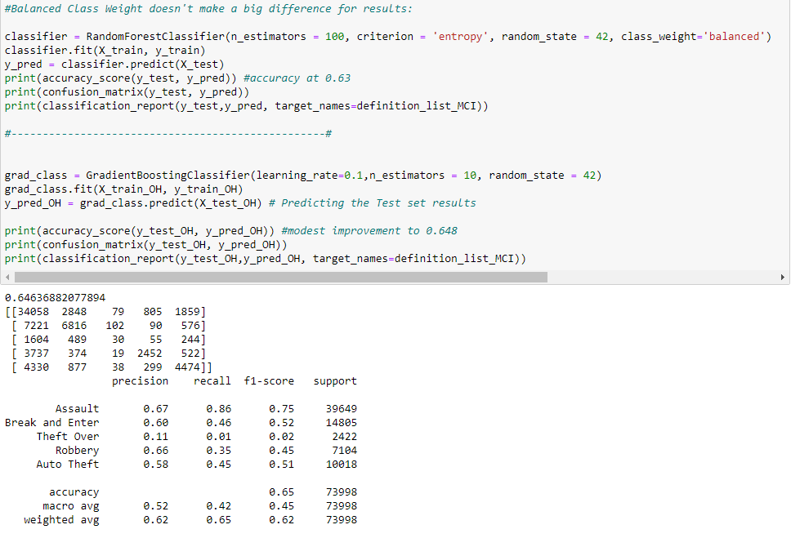
Testing and Result

Slide 20
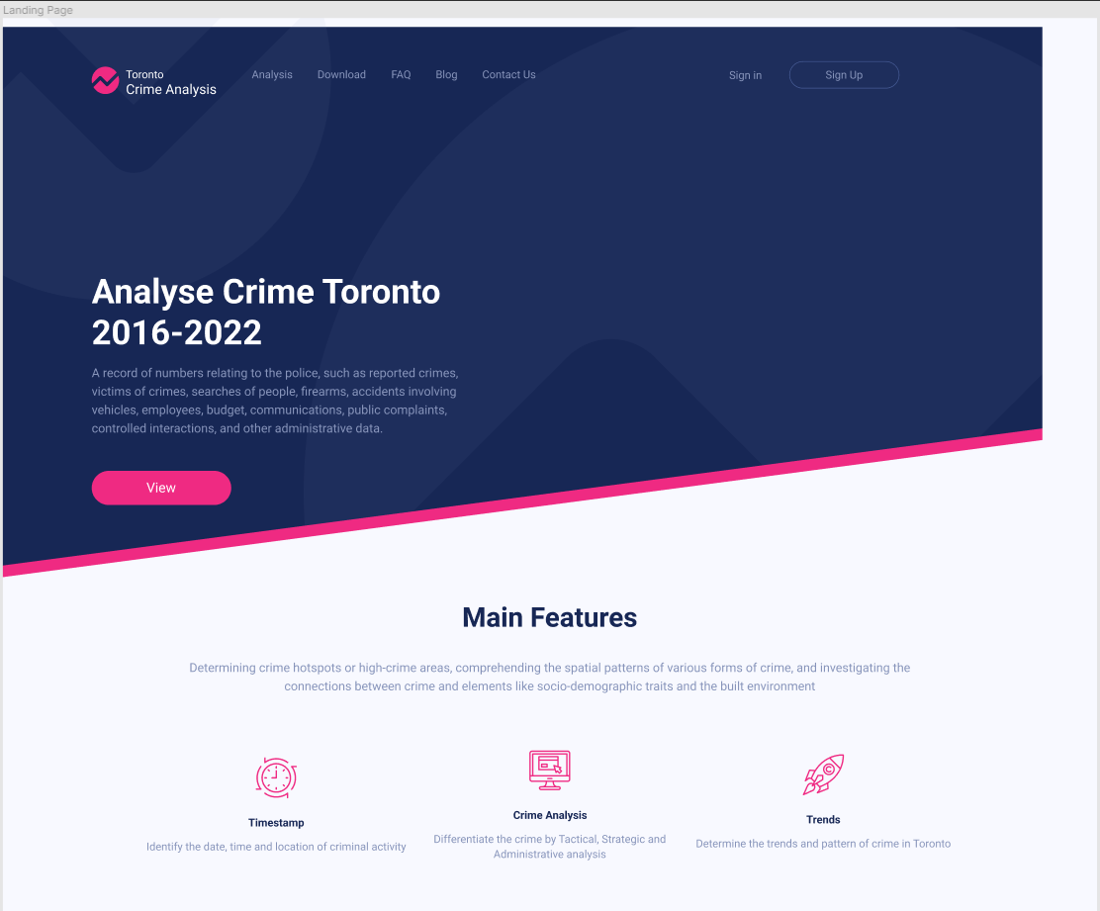
Figma
Prototype of Homepage

Slide 21
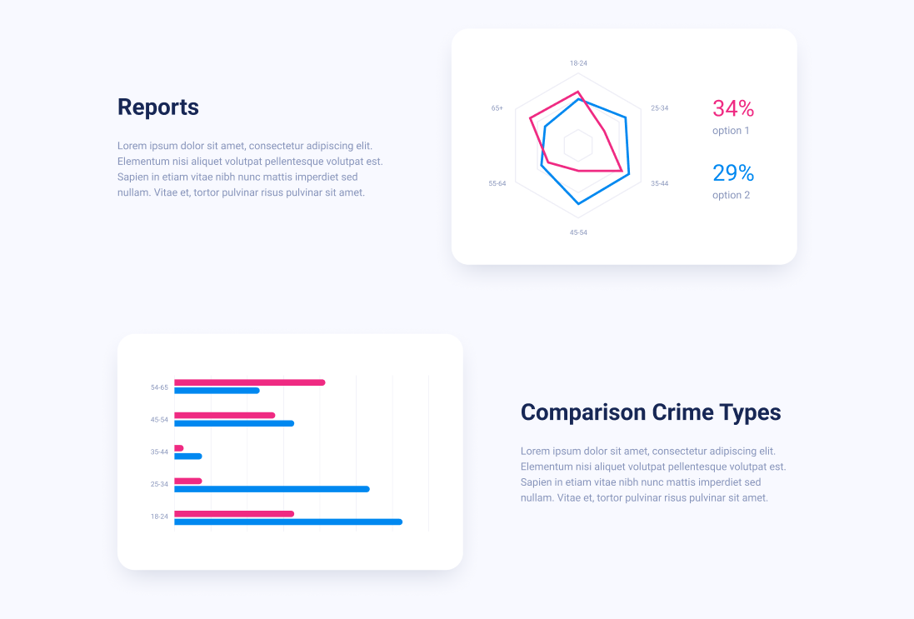
Figma
Prototype of Homepage

Slide 22

INDIVIDUAL CONTRIBUTION
WEEK 1 - 4​
All members worked on the problem statement ​
Brainstorming​
Dataset selection​

Slide 23
INDIVIDUAL CONTRIBUTION
WEEK 5 - 9
​
Kajal : Feasibility study, Documentation
​
Dikesh : New dataset find, Work on academic​​, Web platform
​
Parth : New dataset find, Work on academic​​, Web platform
​
Amandeep : Feasibility study​, Documentation
​
Kanishk : Documentation

Slide 24
INDIVIDUAL CONTRIBUTION
WEEK 9 - 13
​
Kajal : Figma Design, Documentation
​
Dikesh : ML Model, Web platform
​
Parth : ML Model, Web platform
​
Amandeep : Documentation
​
Kanishk : Documentation

Slide 25
Ethical Concern
Crime analysis in Toronto must take ethical considerations into account.
To make sure that crime analysis is carried out in a responsible and ethical manner, privacy, bias, discrimination, responsibility, and transparency are all crucial ethical factors that must be addressed.

Slide 26
References
https://data.torontopolice.on.ca/datasets/TorontoPS::major-crime-indicators-1/about
https://data.torontopolice.on.ca/search?q=crime

Slide 27
Thank You

